Slide 1
Collegedunia - Data Analysis Assessment
Ajay Krishnan
bsajaykrishnanat@gmail.com
LinkedIn : https://www.linkedin.com/in/ajzkrish/

Slide 2
Geospatial Analysis

Slide 3
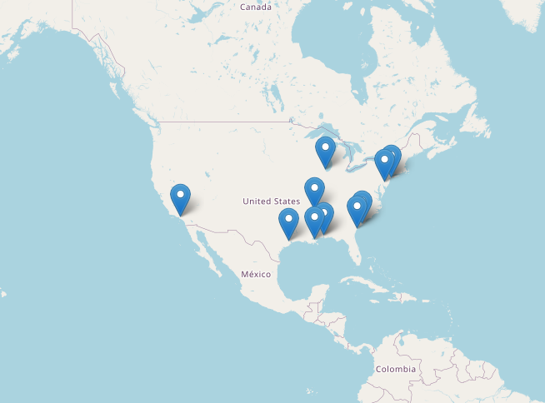
Distribution Centers located in the US

Slide 4
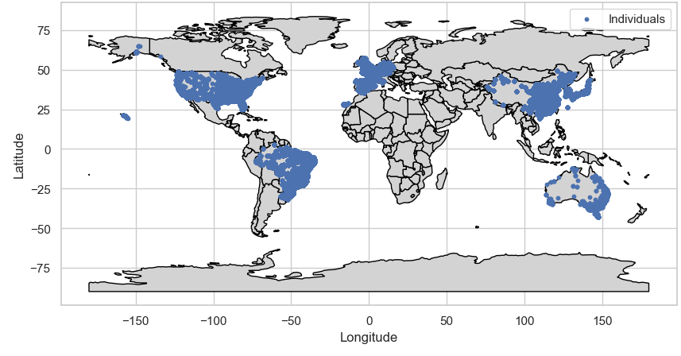
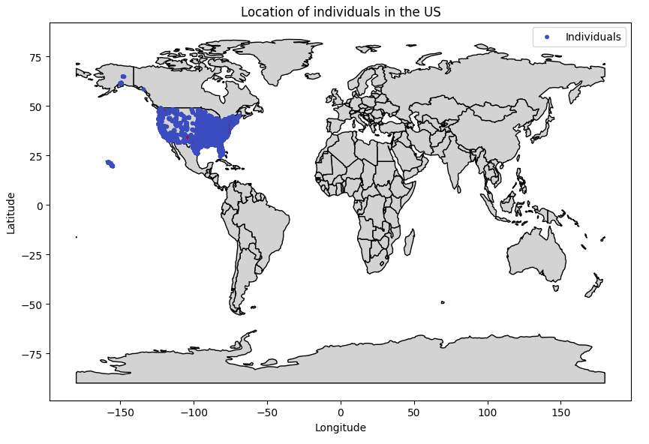
Distribution of users worldwide
Distribution of users in the US

Slide 5
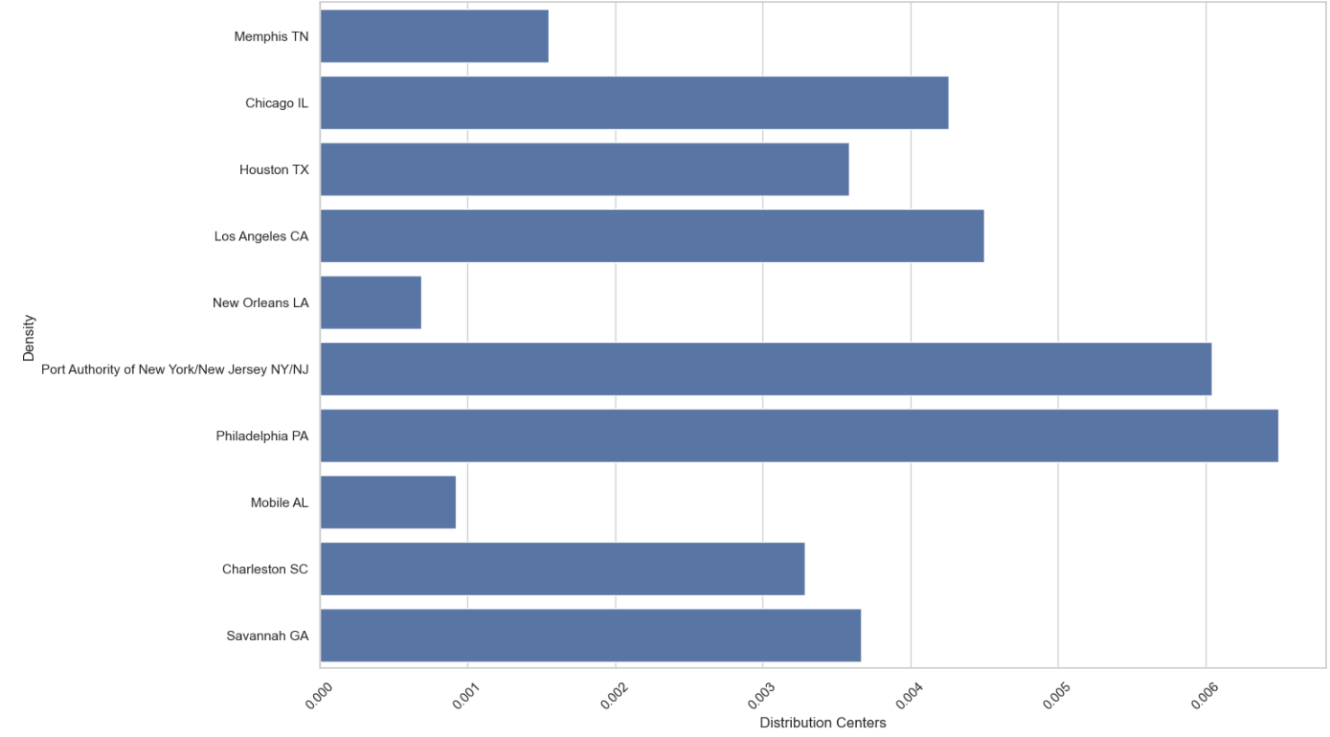
Inference : "Port Authority of New York/New Jersey NY/NJ" and "Philadelphia PA" has the highest user density among all distribution centers

Slide 6
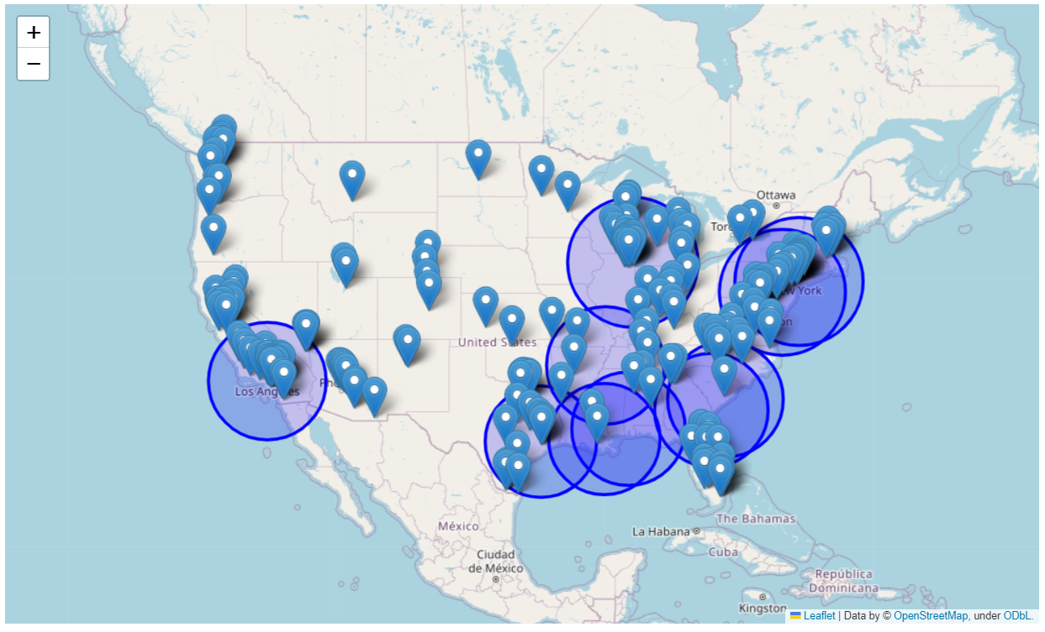
Users and Distribution centers
Inference
The map clearly indicates that the distribution centers experience high population density in the Los Angeles area and across the eastern United States.
Implying the need of more distribution centers in remaining parts (north western parts, Hawaii)

Slide 7
User Behaviour Analysis

Slide 8
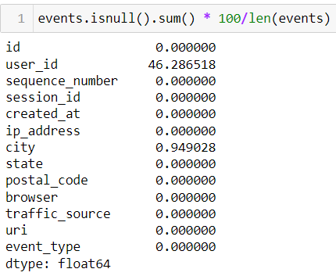
Inference
Due to 46% of 'user_id' values being null, dropping them is advisable.
For 'city' column imputation, opting for the mode is simpler and more practical considering computational constraints.

Slide 9
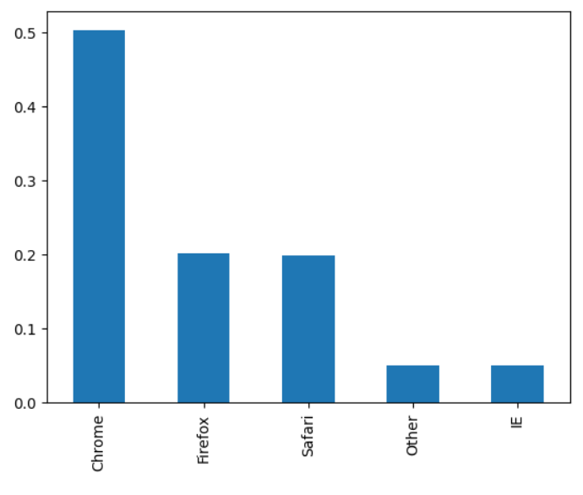
Inference : Chrome is the most used browser (followed by firefox and safari), hence optimising the site for the browser would be fruitful
Browser Usage

Slide 10
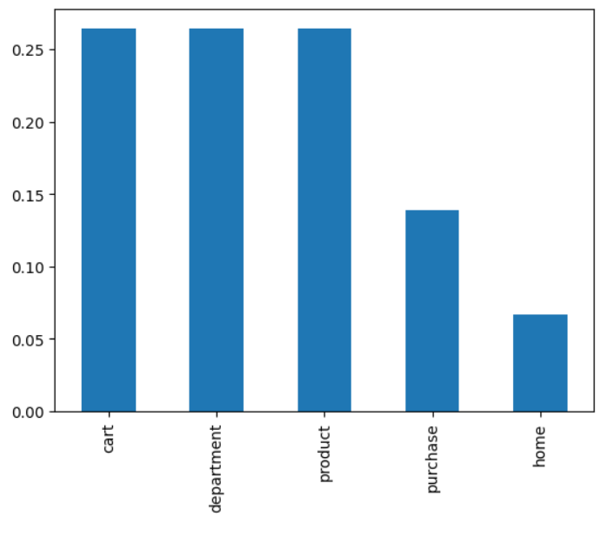
Event Type
Inference: The purchase percentage is relatively low, suggesting that many individuals are browsing products, adding them to their carts, but not completing the purchase.

Slide 11
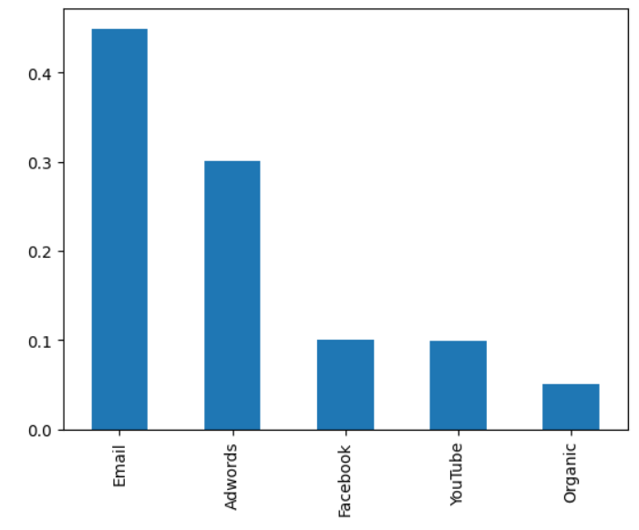
Traffic Source
Inference
High number of traffic is from emails and adwords
Pushing a little bit more on facebook traffic would be beneficial considering that the number of people using facebook is high.

Slide 12
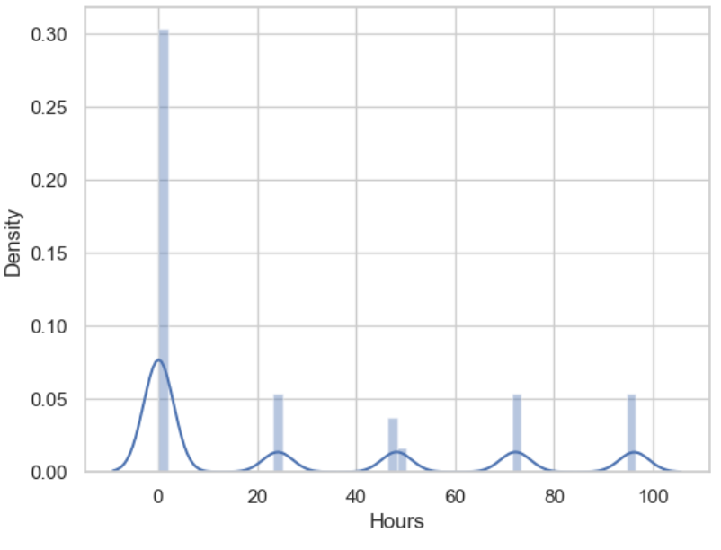
Session Duration
Inference
Approximately 70% of whole sessions are only less than 25 hours
Approximately 60% of whole sessions are only less than 0.5 hours
Approximately 10% of whole sessions are only more than 10 hours

Slide 13
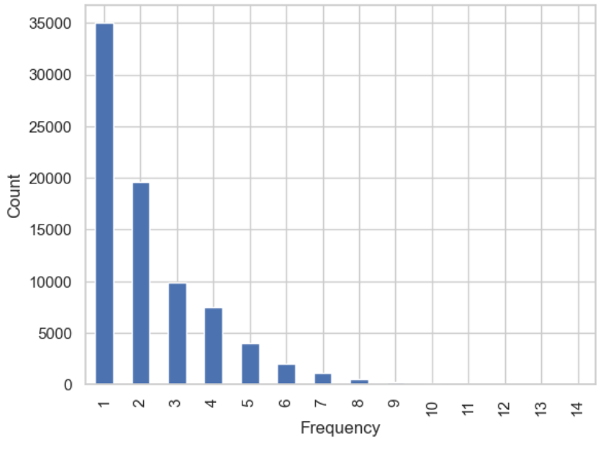
Session Frequency
Inference:
The inference from a high number of users having a session frequency of 1 is that a significant portion of users visit the platform or website only once. This suggests a low level of engagement or interaction beyond the initial visit.
This indicates :
Lack of Retention Strategies
User Experience Issues
Users may have visited the platform to make a one-time transaction

Slide 14
Sales and Revenue Analysis

Slide 15
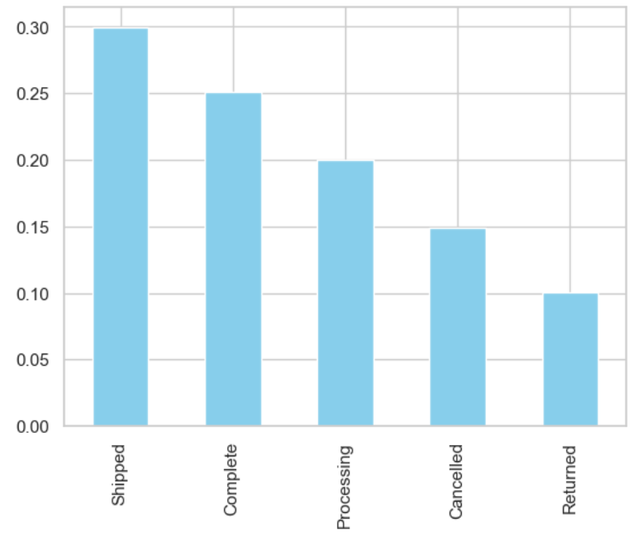
Order Status
Inference
55% of orders are either shipped or completed and 10% returned.
10% return rate suggests a noteworthy proportion of orders experiencing dissatisfaction or issues significant enough for customers to initiate returns.

Slide 16
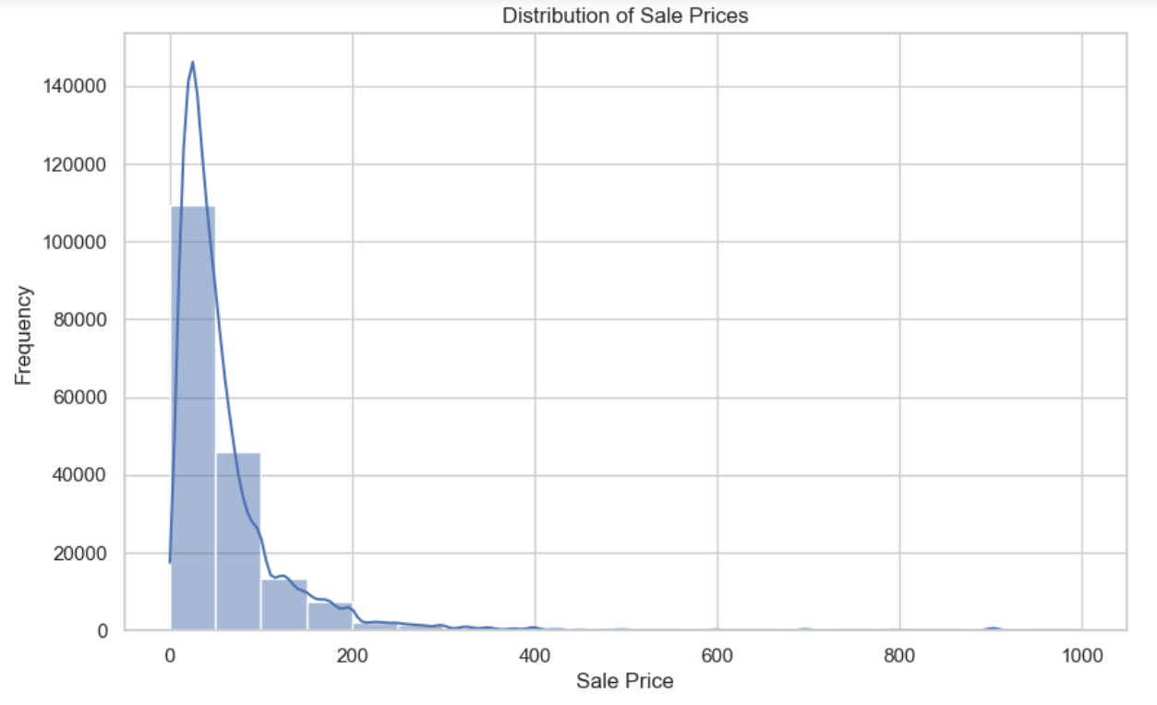
Distribution of Sale Prices
Inference
Very high proportion of data is priced less than 200.
This may suggest a market segment or consumer preference for budget-friendly products within the business's product range.

Slide 17
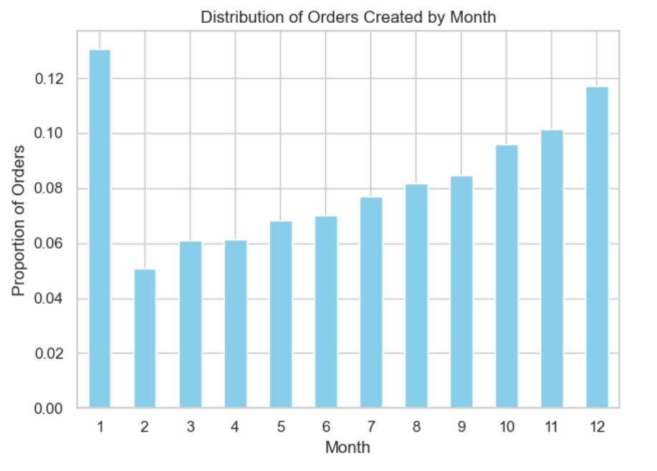
Distribution of Orders Created by Month
Inference
Highest number of order are Placed in the winter seasons (nov-jan)
Understanding and anticipating seasonal fluctuations in demand can be valuable for businesses in planning inventory management, marketing campaigns, and resource allocation to effectively capitalize on peak periods and maximize sales opportunities.

Slide 18
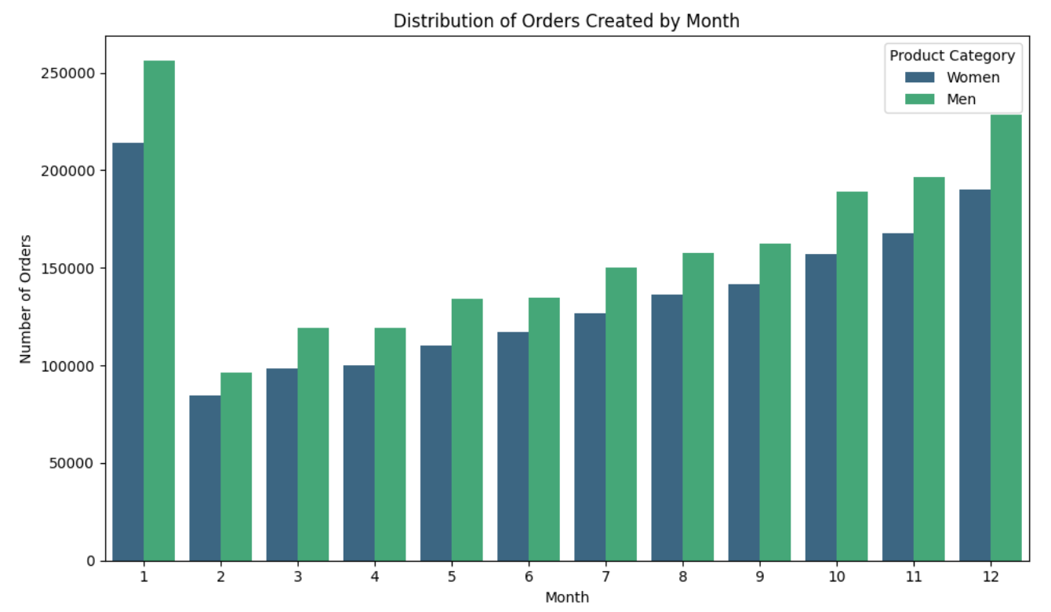
Distribution of Orders Created by Month (Partitioned by gender)
Inference
In all months, product_department - men have higher number of purchase.
Businesses can leverage this insight to optimize product offerings, tailor marketing strategies, and enhance customer engagement efforts.

Slide 19
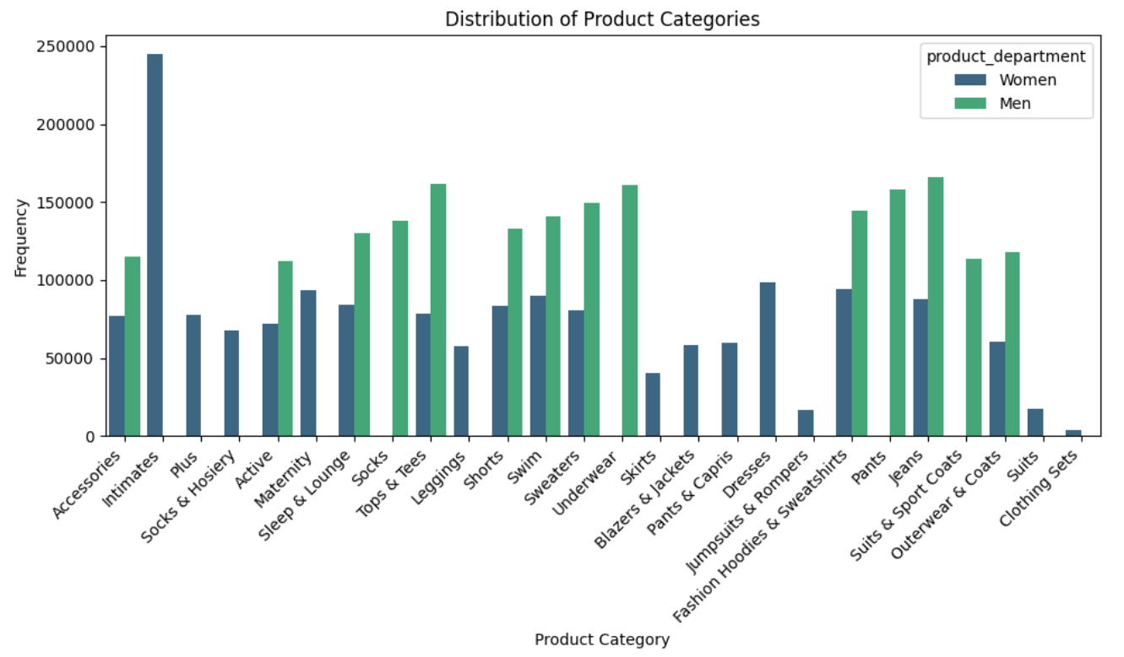
Distribution of Product Categories
Inference
There is a notable number of products that are exclusive for women
The presence of a notable number of products exclusively for women highlights a targeted approach to product segmentation and catering to specific consumer demographics.

Slide 20
Details of revenue from the orders
Total Revenue made from all the orders is 111559298.7420401
Average revenue per sale 31.109841000841918

Slide 21
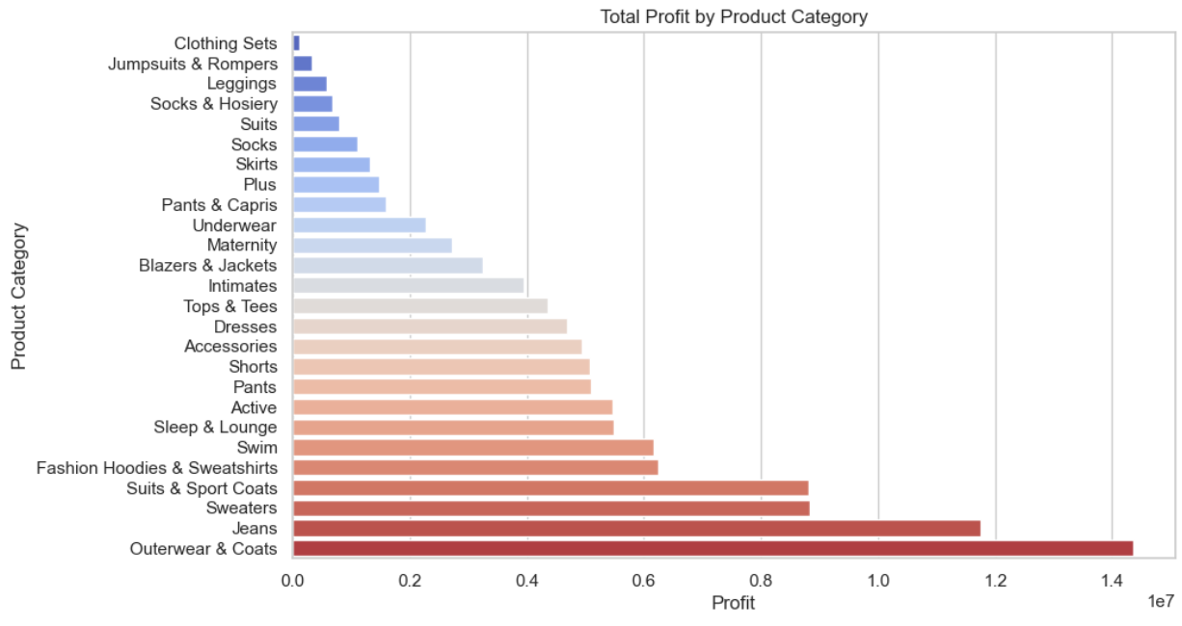
Distribution of profit from each product Categories
Inference
Over coats jeans and sweaters has made highest profit and jumpsuit, clothing sets made lowest profit.
Businesses can leverage this insight to optimize product offerings, adjust pricing strategies, and allocate resources effectively to maximize profitability and drive overall business performance.

Slide 22
Product Performance Analysis

Slide 23
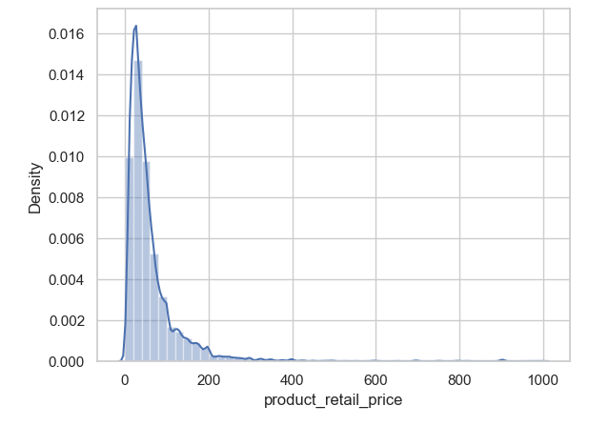
Distribution of Product price
Inference
A heavily left-skewed distribution of selling prices in the dataset suggests that a majority of products are priced lower than the average or median price.
This could indicate a pricing strategy focused on affordability, potentially aiming to capture a larger market share by appealing to price-sensitive consumers.

Slide 24
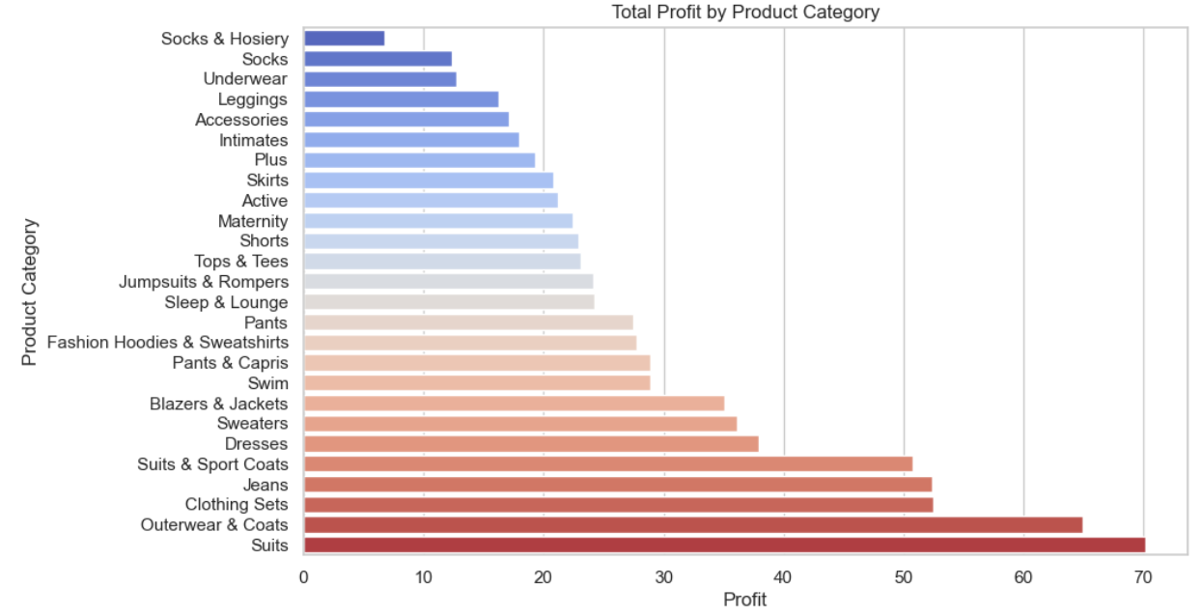
Average Profit by Product Category

Slide 25
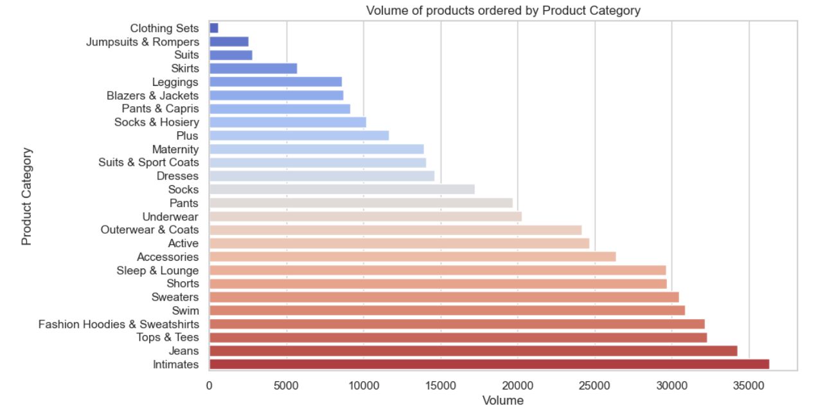
Volume of products ordered by Product Category
Inference
Highest volume of products in inventory are from intimate,jeans,tops and tees category
By focusing on these high-volume product categories, businesses can enhance customer satisfaction, increase repeat purchases, and ultimately, improve overall profitability.

Slide 26
User Demographics Analysis

Slide 27
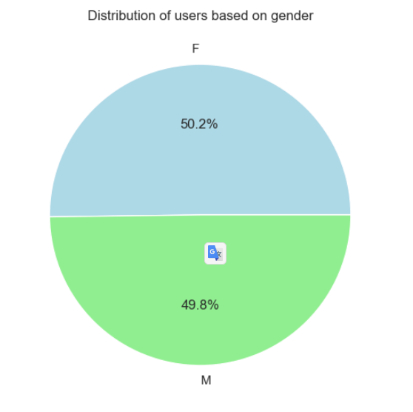
Distribution of users based on gender
Inference
The male-female ration is approximately 50-50.
This suggest the active engagement from both genders.

Slide 28
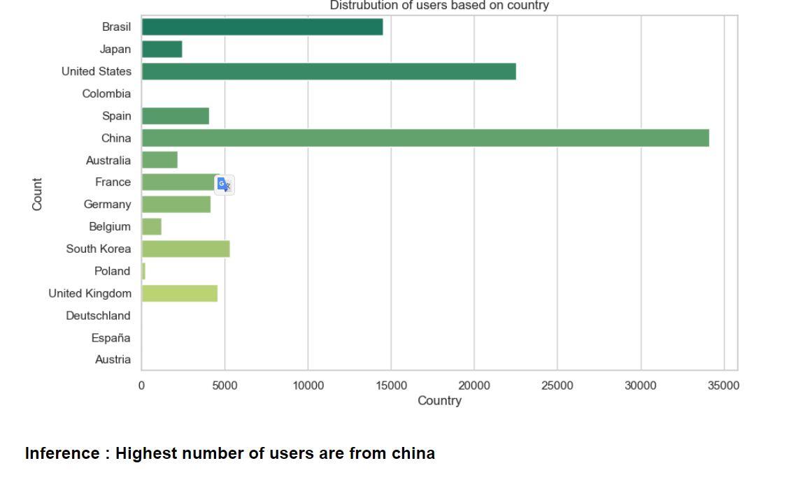
Distribution of users based on country
Inference
Low user numbers in Austria, Spain, Colombia, and Poland indicate potential for market expansion in these regions.

Slide 29
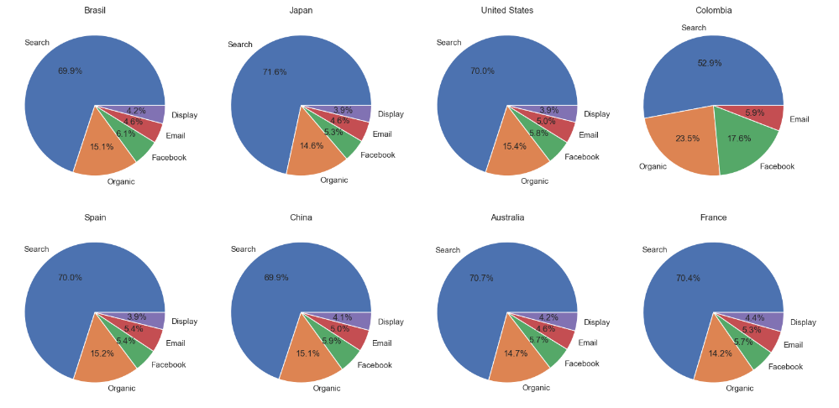
In most countries main contributor to traffic_source is 'search'
Distribution of traffic source in each country
Inference

Slide 30
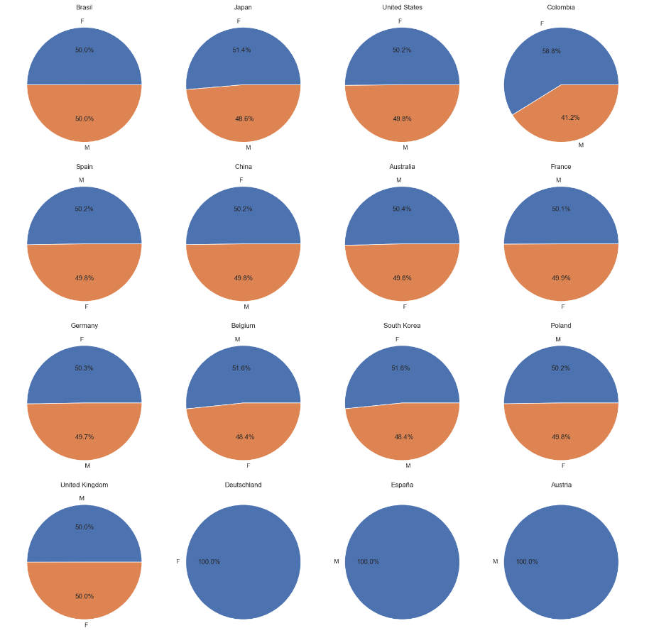
Distribution of gender in each country
Inference
In the majority of countries, the male-female ratio is balanced, except in Germany, Spain, and Austria where it is entirely dominated by one gender (but the number of users is very low).
This could indicate varying cultural, social, or economic factors influencing gender participation or representation in different regions.

Slide 31
Order Fulfilment Analysis

Slide 32
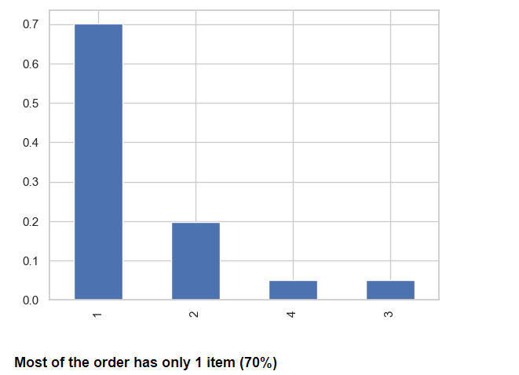
Order vs number of items
Inference
The majority of orders consisting of only one item may indicate a pattern of individual or single-item purchases rather than bulk orders or larger transactions.
This insight suggests potential opportunities for strategies aimed at increasing order size or encouraging customers to purchase complementary products.

Slide 33
Shipping, Delivery and Return duration Inference
Average Shipping Duration: 13 Hours
Orders are swiftly processed and dispatched within approximately 12 hours, reflecting efficient logistics.
Average Delivery Duration: 2.5 Days
Customers typically receive their orders in about 2 days and 12 hours, showcasing relatively prompt delivery times.
Average Return Duration: 1.5 Days
Returns are efficiently processed within approximately 1 day and 12 hours, ensuring a smooth customer experience.

Slide 34
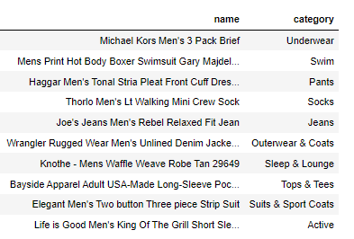
Top Product from ordered (number of orders).
These are the top product ordered

Slide 35
Insights and suggestions
Address the significant proportion of canceled and returned items through targeted sales strategies and consumer engagement.
Improve average delivery times to enhance overall customer satisfaction.
Encourage bulk ordering and promote complementary items to increase the number of items per order and maximize sales potential.

Slide 36
END
Ajay Krishnan
bsajaykrishnanat@gmail.com
LinkedIn : https://www.linkedin.com/in/ajzkrish/
Github : https://github.com/ajay-ajzkrish

